Slide 1


Delmon Arous
31.07.2023

Slide 2

Outline
Executive Summary
Introduction
Methodology
Results
Conclusion
Appendix

Slide 3
Executive Summary
Summary of methodologies
Data Collection through API
Data Collection with Web Scraping
Data Wrangling
Exploratory Data Analysis with SQL
Exploratory Data Analysis with Data Visualization
Interactive Visual Analytics with Folium
Interactive Dashboard with Plotly Dash
Predictive Analysis (Classification) using Machine Learning
Summary of all results
Exploratory Data Analysis result
Interactive Analytics in screenshots
Predictive Analysis result

Slide 4
Introduction
Project background and context
Space X advertises Falcon 9 rocket launches on its website with a cost of 62 million dollars; other providers cost upward of 165 million dollars each, much of the savings is because Space X can reuse the first stage. Therefore, if we can determine if the first stage will land, we can determine the cost of a launch. This information can be used if an alternate company wants to bid against space X for a rocket launch. This goal of the project is to create a machine learning pipeline to predict if the first stage will land successfully.
Problems you want to find answers
What factors determine if the rocket will launch and land successfully?
The interaction amongst various features that determine the success rate of a successful launch and landing
What operating conditions needs to be in place to ensure a launch and successful landing program

Slide 5

Section 1

Slide 6
Methodology
Executive Summary
Data collection methodology:
The SpaceX launch data was gathered from the SpaceX REST API (https://api.spacexdata.com/v4/rockets/)
WebScraping (https://en.wikipedia.org/wiki/List_of_Falcon/_9/_and_Falcon_Heavy_launches) (BeautifulSoup)
Perform data wrangling
Collected data was transformed into a clean dataset to make the dataset viable and meaningful for analysis (Pandas)
Perform exploratory data analysis (EDA) using visualization and SQL
Perform interactive visual analytics using Folium and Plotly Dash
Perform predictive analysis using classification models
Build a machine learning pipeline to predict if the first stage of the Falcon 9 lands successfully (incl. preprocessing, standardizing data and dividing data into training and testing datasets for model training and evaluation)

Slide 7
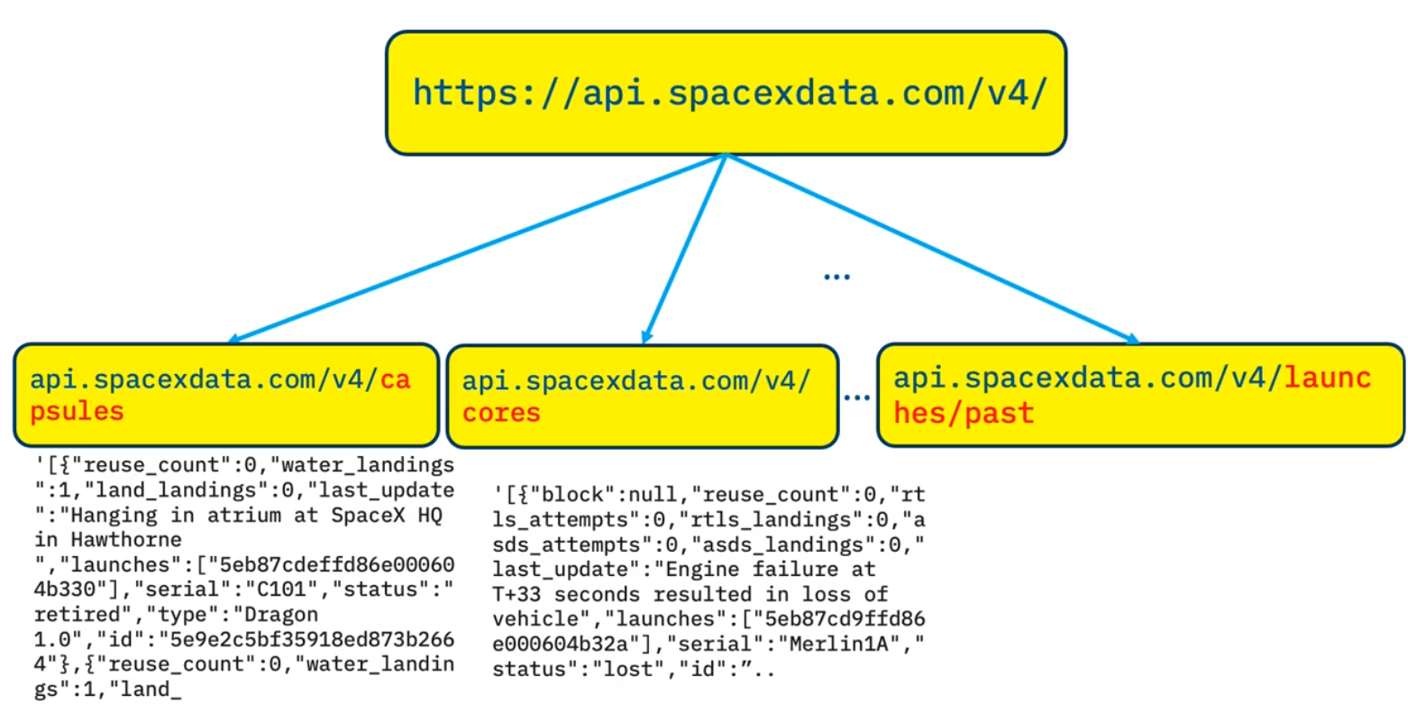
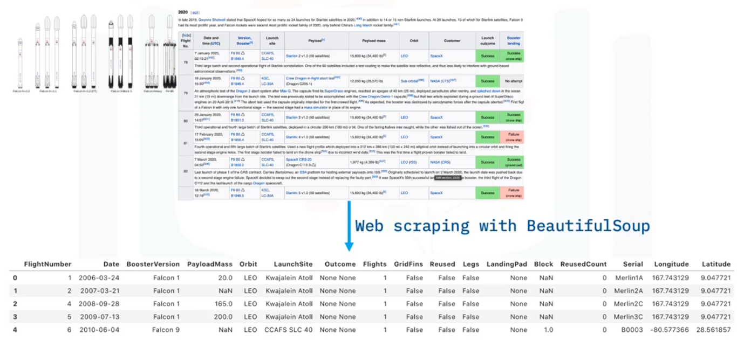
Data Collection
The SpaceX REST API (https://api.spacexdata.com/v4/rockets/) yield data about launches, including information about the rocket used, payload delivered, launch specifications, landing specifications, and landing outcome
Goal: use this data to predict whether SpaceX will attempt to land a rocket or not
Web scraping Falcon 9 Launch records (https://en.wikipedia.org/wiki/List_of_Falcon/_9/_and_Falcon_Heavy_launches) with BeautifulSoup

Slide 8
Data Collection – SpaceX API
SpaceX offers a public API from where data can be obtained and then used
GitHub URL: https://github.com/tehm0n/Coursera/blob/main/Course%2010%20-%20Applied%20Data%20Science%20Capstone/Module%201%20-%20Introduction/jupyter-labs-spacex-data-collection-api.ipynb
Perform get request to obtain launch data
Response will be in the form of a JSON
request.get(url)
pd.json_normalize(response.json())
Filter dataframe to include only Falcon 9 launches
Convert JSON to a Pandas dataframe and normalize
Data wrangling: dealing with NaN and NULL values

Slide 9
Data Collection - Scraping
Python BeautifulSoup package to web scrape some HTML tables from Wikipedia (https://en.wikipedia.org/wiki/List_of_Falcon/_9/_and_Falcon_Heavy_launches) that contain valuable Falcon 9 launch records
GitHub URL: https://github.com/tehm0n/Coursera/blob/main/Course%2010%20-%20Applied%20Data%20Science%20Capstone/Module%201%20-%20Introduction/jupyter-labs-webscraping.ipynb
Web scrape HTML tables containing launch records
Parse the data from those tables
Filter dataframe to include only Falcon 9 launches
Convert them into a Pandas dataframe
Data wrangling: dealing with NaN and NULL values

Slide 10
Data Wrangling
Perform some Exploratory Data Analysis (EDA); dealing with missing values
Summarize launches on each site, occurrences of each orbit and occurrences of mission outcome per orbit type
Convert mission outcomes into training labels (0/1)
GitHub URL: https://github.com/tehm0n/Coursera/blob/main/Course%2010%20-%20Applied%20Data%20Science%20Capstone/Module%201%20-%20Introduction/labs-jupyter-spacex-data_wrangling_jupyterlite.ipynb
Perform Exploratory Data Analysis (EDA)
Calculate summarization of launch data
Convert mission outcomes into labels

Slide 11
EDA with SQL
Perform some Exploratory Data Analysis using a database with SQL
The following SQL queries were performed:
display the names of the unique launch sites in the space mission
display 5 records where launch sites begin with the string 'CCA’
display the total payload mass carried by boosters launched by NASA (CRS)
display average payload mass carried by booster version F9 v1.1
list the date when the first successful landing outcome in ground pad was achieved
list the names of the boosters which have success in drone ship and have payload mass greater than 4000 but less than 6000
list the total number of successful and failure mission outcomes
list the names of the booster versions which have carried the maximum payload mass through a subquery
list the records which will display the month names, failure landing outcomes in drone ship, booster versions, launch site for the months in year 2015
rank the count of landing outcomes between the date 2010-06-04 and 2017-03-20, in descending order
GitHub URL: https://github.com/tehm0n/Coursera/blob/main/Course%2010%20-%20Applied%20Data%20Science%20Capstone/Module%202%20-%20Exploratory%20Data%20Analysis%20(EDA)/jupyter-labs-eda-sql-coursera_sqllite.ipynb

Slide 12
EDA with Data Visualization
Perform Exploratory Data Analysis (EDA) and Feature Engineering to predict if the Falcon 9 first stage will land successfully
Employing Pandas and Matplotlib to explore data and to produce scatterplots, line plots and bar plots to visualize the relationship between pair of features:
Scatter plot: Flight number vs Launch site, Payload mass vs Launch site, Flight number vs Orbit type, Payload mass vs Orbit type
Bar plot: Orbit type vs Success rate
Line plot: Yearly trend of launch success
GitHub URL: https://github.com/tehm0n/Coursera/blob/main/Course%2010%20-%20Applied%20Data%20Science%20Capstone/Module%202%20-%20Exploratory%20Data%20Analysis%20(EDA)/jupyter-labs-eda-dataviz.ipynb

Slide 13
Build an Interactive Map with Folium
Analyze launch site locations and proximities with Folium:
mark the launch site locations and their close proximities on an interactive map
explore the map with created markers and discover any underlying patterns
by that, explain how to choose an optimal launch site
Tasks:
mark all launch sites on a Folium map by adding markers (points) and circles (highlighted areas) around a coordinate points
mark the success/failed launches for each site on the map by adding color-labeled markers in marker clusters
calculate the distances between a launch site to its proximities by adding lines (indicating distances between two coordinate points)
GitHub URL: https://github.com/tehm0n/Coursera/blob/main/Course%2010%20-%20Applied%20Data%20Science%20Capstone/Module%203%20-%20Interactive%20Visual%20Analytics%20and%20Dashboard/lab_jupyter_launch_site_location.ipynb

Slide 14
Build a Dashboard with Plotly Dash
Build a dashboard application with the Python Plotly Dash package
Contains input components such as a dropdown list (for launch site selection) and a range slider (for payload range selection) to interact with:
a pie chart showing the total launches for each launch site
a scatter point chart showing the correlation between payload mass and launch success for different booster version
Can be employed to find insights from the SpaceX dataset more easily than with static graphs
GitHub URL: https://github.com/tehm0n/Coursera/blob/main/Course%2010%20-%20Applied%20Data%20Science%20Capstone/Module%203%20-%20Interactive%20Visual%20Analytics%20and%20Dashboard/spacex_dash_app.py

Slide 15
Predictive Analysis (Classification)
Build a machine learning pipeline to predict if the first stage of the Falcon 9 lands successfully. This includes:
Preprocessing, allowing to create a column for landing outcome labels and standardize data (NumPy, Pandas, Scikit-Learn)
Split into training data and testing data (Scikit-Learn)
Classification model training by performing a Grid Search, allowing to find the hyperparameters that yields most optimal performance for the model algorithm (Scikit-Learn)
Using the best hyperparameter values, find the classification model with the best accuracy using the testing data (Scikit-Learn)
Classification models tested: logistic regression, support vector machines, decision tree classifier and K-nearest neighbors
GitHub URL: https://github.com/tehm0n/Coursera/blob/main/Course%2010%20-%20Applied%20Data%20Science%20Capstone/Module%204%20-%20Predictive%20Analysis%20(Classification)/SpaceX_Machine_Learning_Prediction_Part_5.ipynb
Create labeled column for landing outcome
Standardize data
Find optimal hyperparameters via GridSearchCV
Split data into training and testing data
Score each classification model

Slide 16
Results
Exploratory data analysis results
Interactive analytics demo in screenshots
Predictive analysis results

Slide 17

Section 2

Slide 18
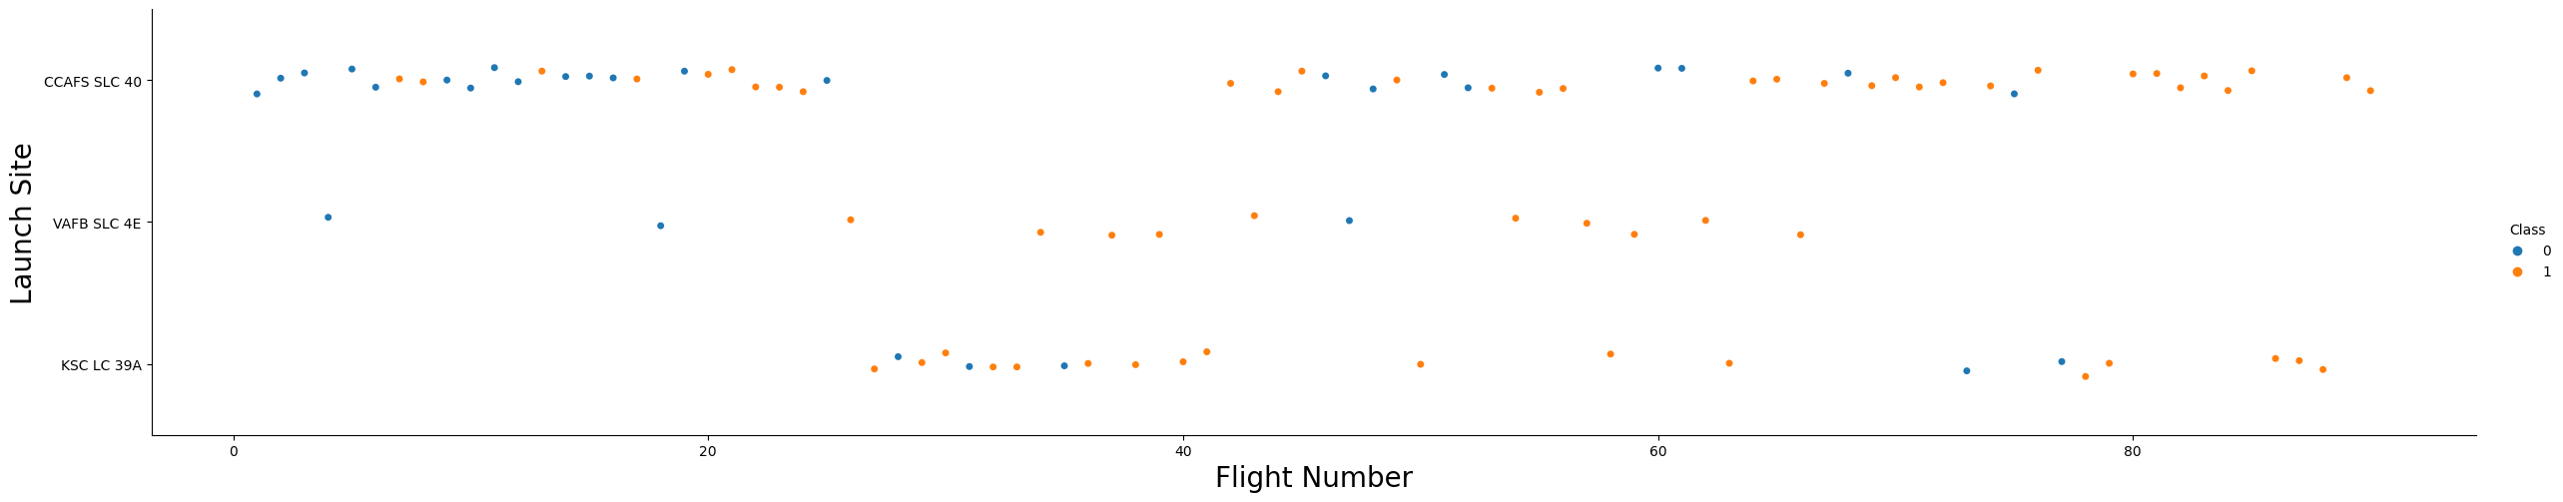
Flight Number vs. Launch Site
The larger the flight amount at a launch site, the greater the success rate at a launch site

Slide 19
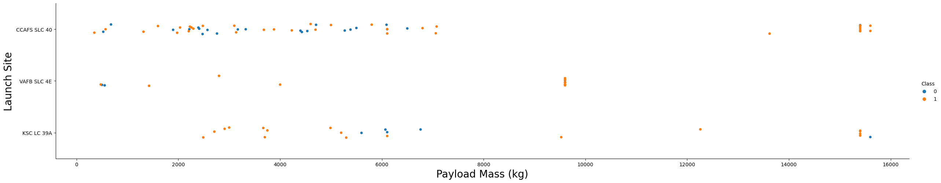
Payload vs. Launch Site
For the VAFB-SLC launch site, there are no rockets launched for heavy payload mass (greater than 10000)
The greater the payload mass for launch site CCAFS SLC 40, the higher the success rate for the rocket

Slide 20
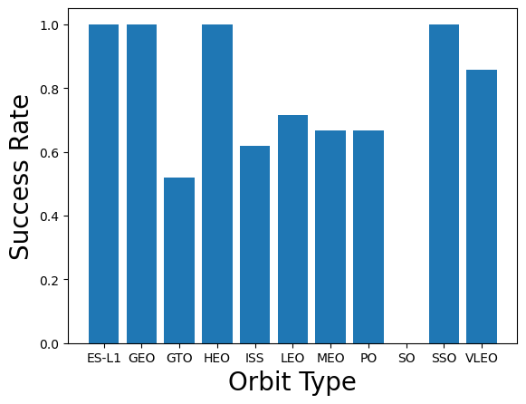
Success Rate vs. Orbit Type
The orbits ES-L1, GEO, HEO, SSO and VLEO have the highest success rates

Slide 21
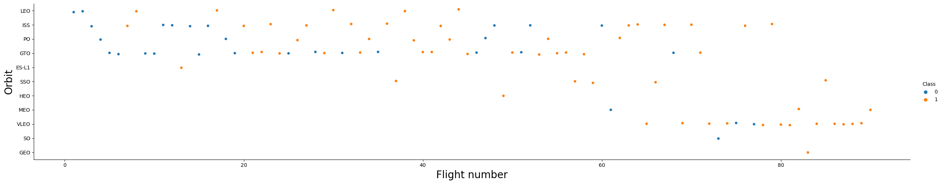
Flight Number vs. Orbit Type
For the LEO orbit, the success appears related to the number of flights (higher success for increasing flight number)
For the GTO orbit, there is no relationship between the orbit and flight number
Generally, the success rate increases with increasing flight number for each orbit

Slide 22
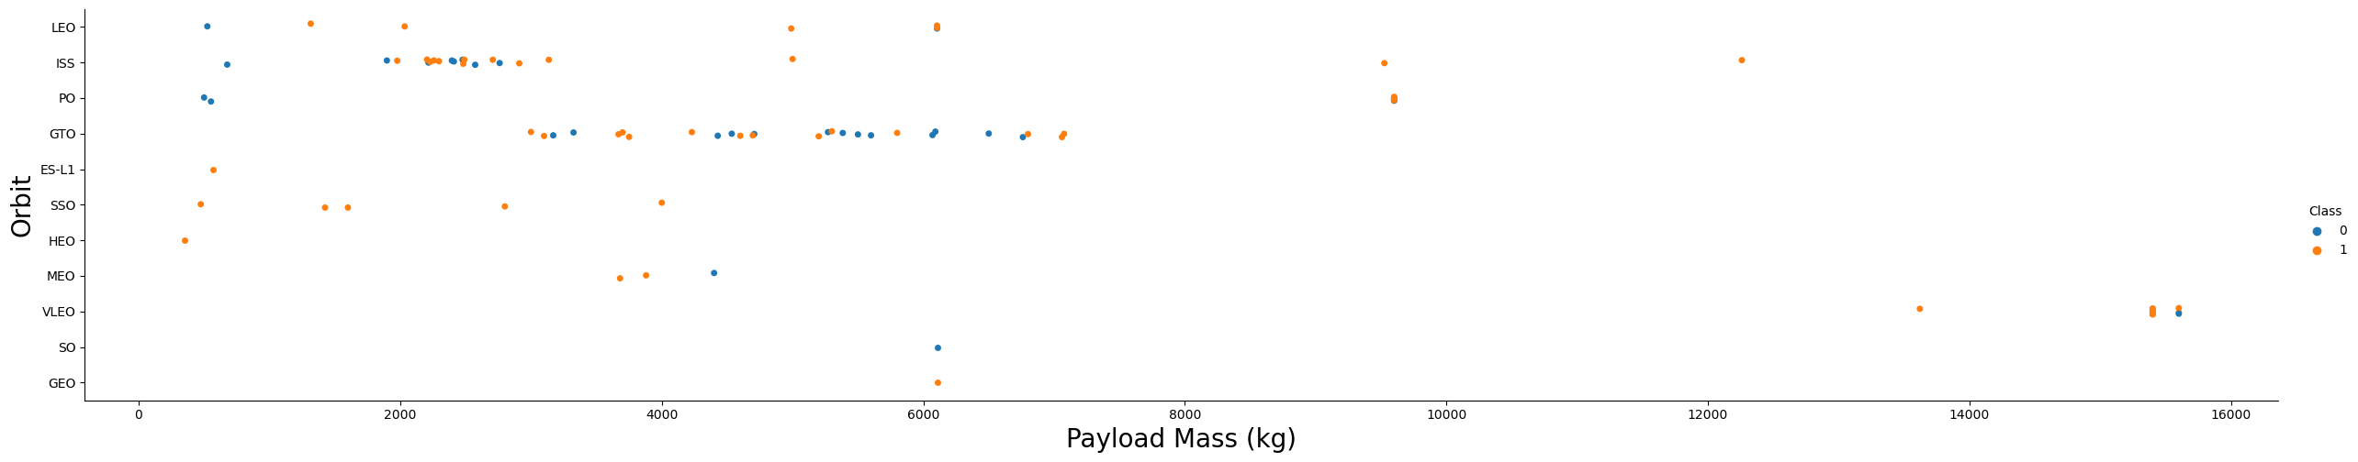
Payload vs. Orbit Type
With heavy payloads, the successful landing rate is more for the Polar, LEO and ISS orbit
For the GTO orbit, cannot distinguish relationship with payload as successful and unsuccessful landing rate are prominent

Slide 23
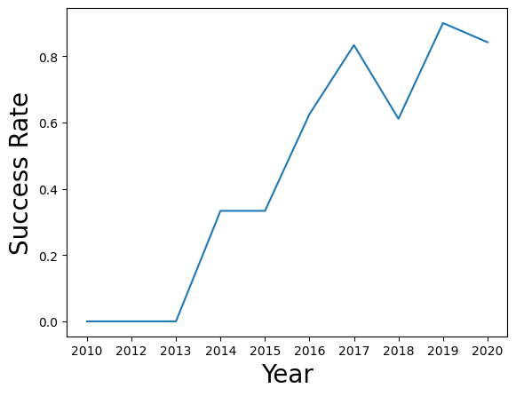
Launch Success Yearly Trend
The success rate since 2013 kept increasing till 2020

Slide 24
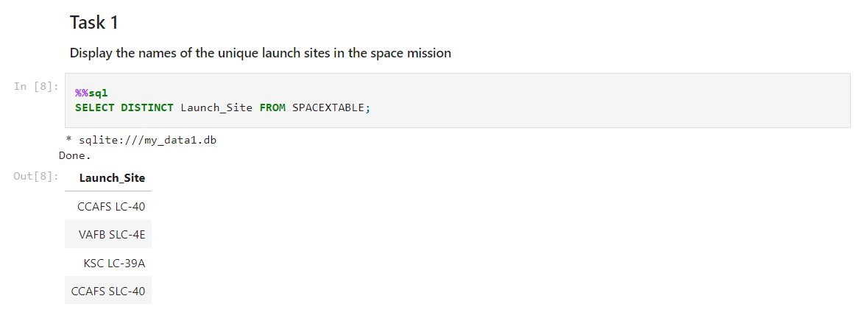
All Launch Site Names
DISTINCT function is employed to display the unique names of the launch sites in the space mission: CCAFS LC-40, VAFB SLC-4E, KSC LC-39A, CCAFS SLC-40

Slide 25
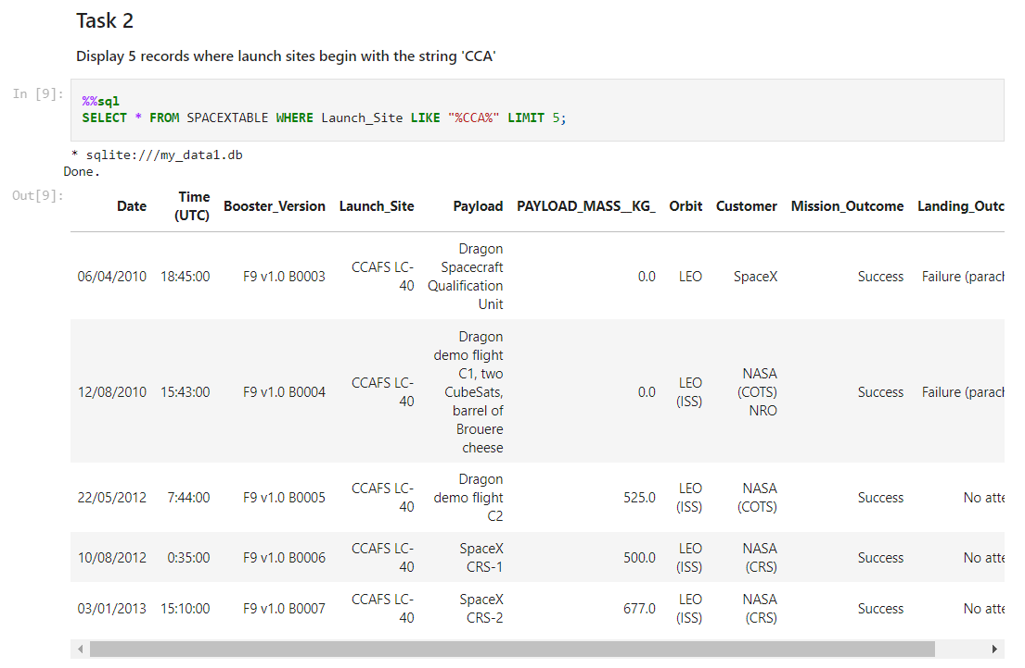
Launch Site Names Begin with 'CCA'
Find 5 records where launch sites begin with ‘CCA’
The combination of WHERE clause and the wildcard LIKE “%CCA%” was used to find relevant launch sites

Slide 26
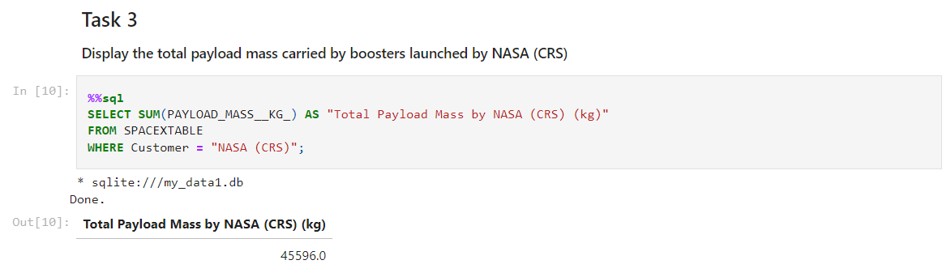
Total Payload Mass
Calculate the total payload carried by boosters from NASA: 45596.0 kg
The SUM() function was used to calculate total payload mass, while the WHERE clause was used to filter for boosters launched by NASA (CRS)

Slide 27
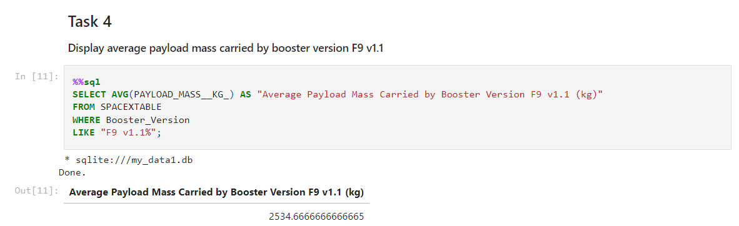
Average Payload Mass by F9 v1.1
Calculate the average payload mass carried by booster version F9 v1.1: 2534.67 kg
The AVG() function was used to calculate average payload mass, while the combination of WHERE clause and the wildcard LIKE “F9 v1.1%” was used to filter for rockets with booster version F9 v1.1

Slide 28
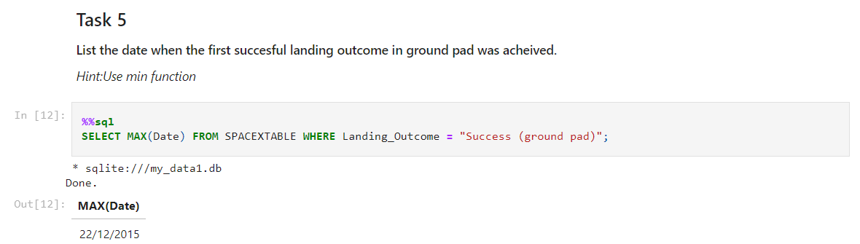
First Successful Ground Landing Date
Find the date of the first successful landing outcome on ground pad: 22/12/2015
The MAX() function and the WHERE clause is used to find the earliest successful landing outcome on ground pad

Slide 29
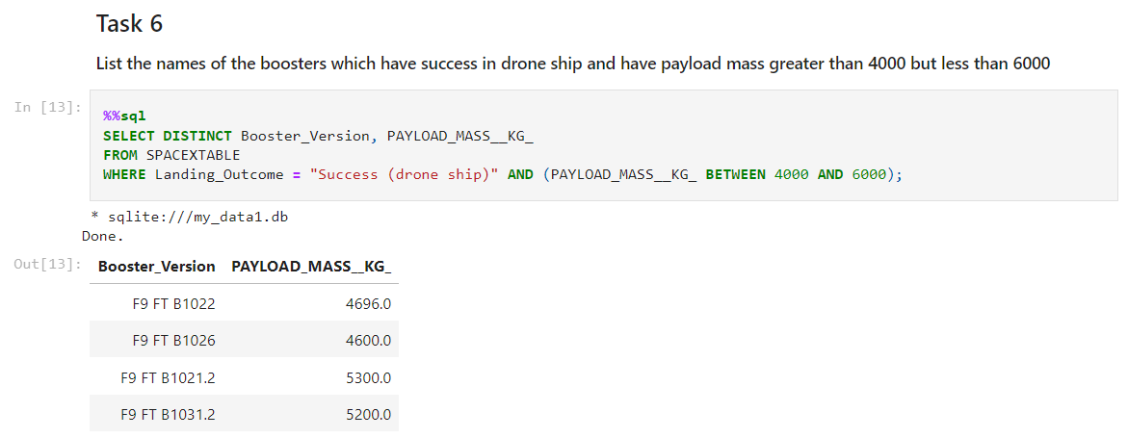
Successful Drone Ship Landing with Payload between 4000 and 6000
List the names of boosters which have successfully landed on drone ship and had payload mass greater than 4000 but less than 6000: F9 FT B1022, F9 FT B1026, F9 FT B1021.2, F9 FT B1031.2
Employed a WHERE clause to filter which booster have successfully landed on drone ship and applied the AND condition to determine successful landing with payload mass greater than 4000 but less than 6000

Slide 30
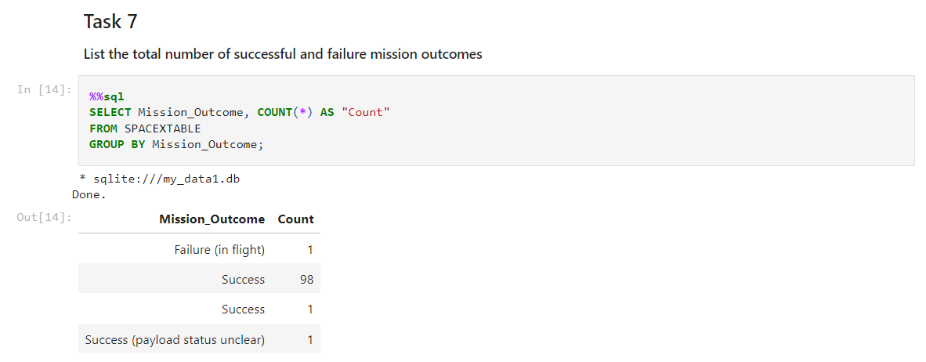
Total Number of Successful and Failure Mission Outcomes
Calculate the total number of successful and failure mission outcomes: Failure in flight (1), Success (99), Success with payload status unclear (1)
The COUNT() function and the GROUP BY clause is used to calculate the total number of mission outcomes

Slide 31
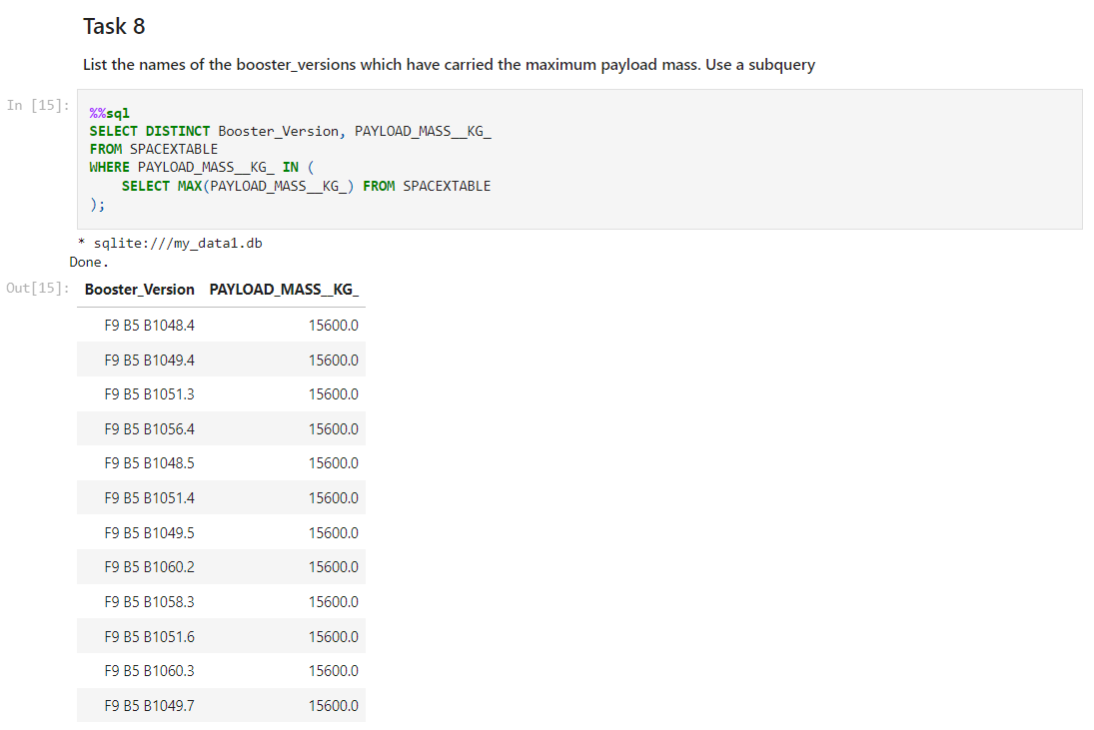
Boosters Carried Maximum Payload
List the names of the booster which have carried the maximum payload mass
A subquery in the WHERE clause and the MAX() function is employed to find the relevant boosters

Slide 32
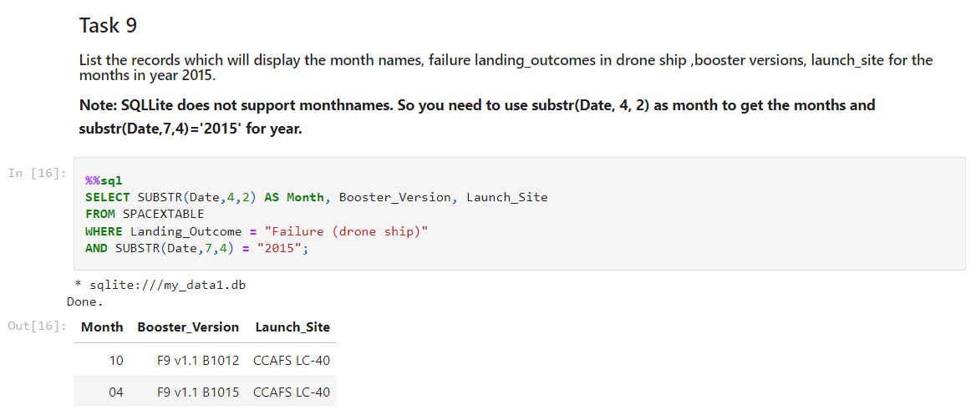
2015 Launch Records
List the failed landing outcomes in drone ship, their booster versions, and launch site names for in year 2015
Used a combinations of the WHERE and AND clause to filter for failed landing outcomes in drone ship for year 2015

Slide 33
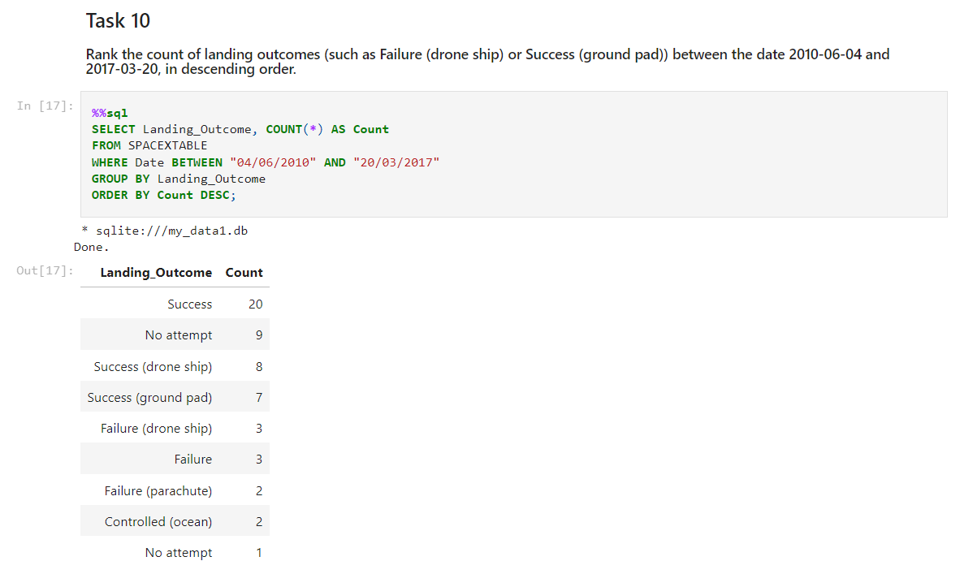
Rank Landing Outcomes Between 2010-06-04 and 2017-03-20
Rank the count of landing outcomes (such as Failure (drone ship) or Success (ground pad)) between the date 2010-06-04 and 2017-03-20, in descending order
The COUNT() function is used to count the different landing outcomes, the WHERE clause to filter for landing outcomes BETWEEN 2010-06-04 to 2017-03-20, the GROUP BY clause to classify landing outcomes and the ORDER BY clause to order the grouped landing outcomes in descending order

Slide 34

Section 3

Slide 35
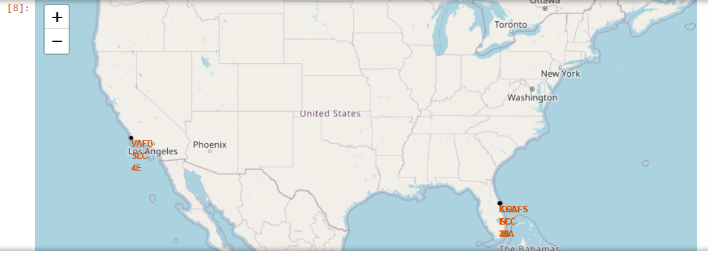
All launch sites marked on a Folium map
All SpaceX launch sites are located near the coast in the Unites States; 3 sites in Florida and 1 site in California
Markers are (longitude, latitude) coordinate points and circles are highlighted areas around each coordinate point

Slide 36
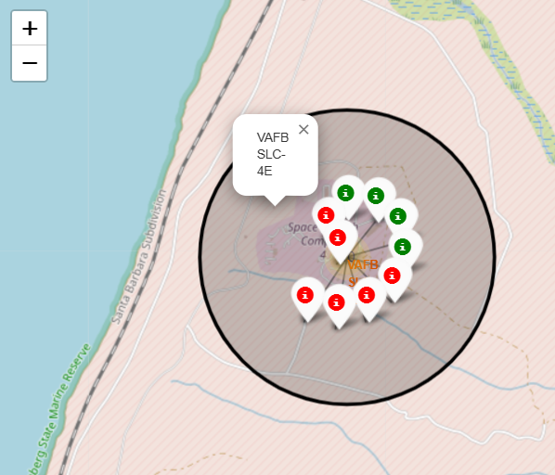
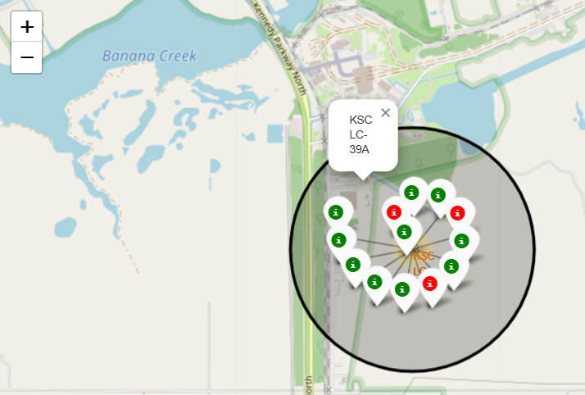
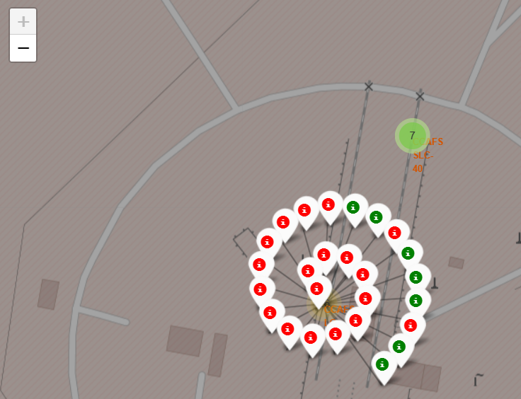
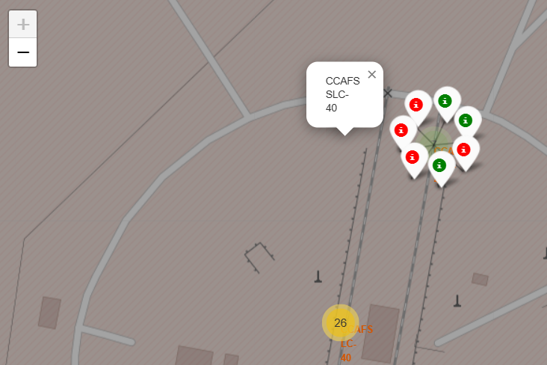
Successful/failed launches for each site
Success and failed launches for each launch site on the Folium map is displayed using color-labeled markers in marker clusters
Green markers represent successful launches, red markers represents failed launches
Site VAFB SLC-4E
Site KSC LC-39A
Site CCAFS LC-40
Site CCAFS SLC-40
Launch site in California
Launch sites in Florida

Slide 37
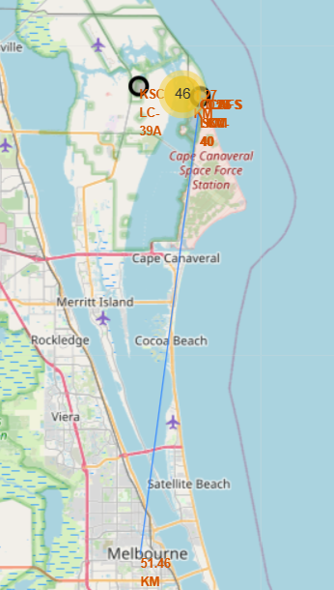
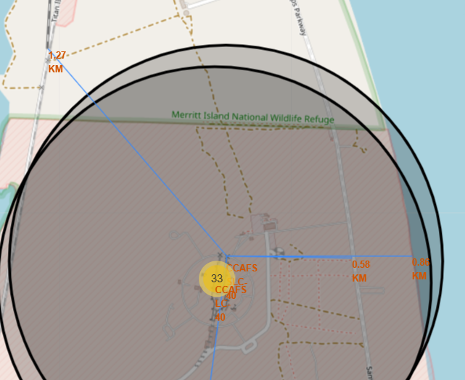
Proximity calculations from launch site
Estimate and display distances between a selected launch site (CCAFS SLC-40) to its proximities by adding lines (indicating distances between two coordinate points)
Distance between the CCAFS SLC-40 site to its nearest proximities: coastline (0.86 km), railway (NASA Railroad; 1.27 km), highway (Samuel C Philips Pkwy; 0.58 km), city (Melbourne; 51.46 km)

Slide 38

Section 4

Slide 39
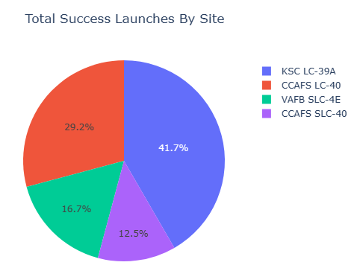
Launch Success Count for All Sites
Pie chart of total successful launches by site
The KSC LC-39A has the highest launch success ratio of all the sites

Slide 40
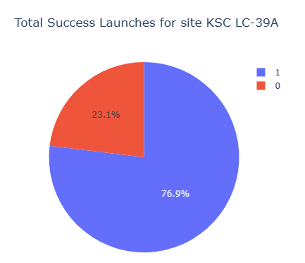
Total Successful launches for Launch Site KSC LC-39A
Pie chart for the launch site (KSC LC-39A) with highest launch success ratio
The KSC LC-39A site achieved a 76.9% success rate (blue) while getting a 23.1% failure rate (red)

Slide 41
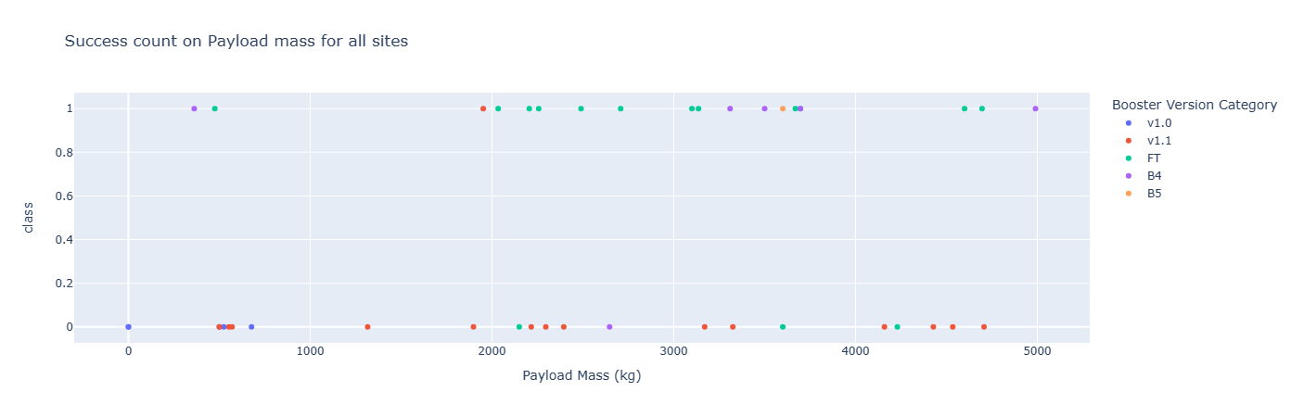
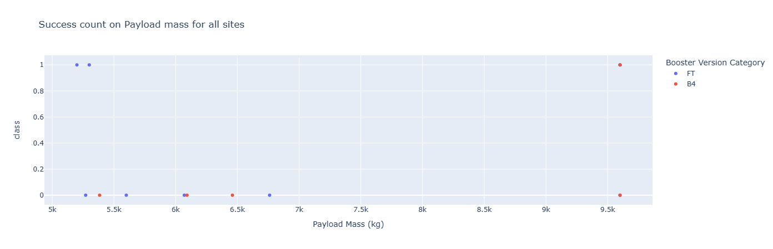
Payload Mass vs Launch Outcome for all Launch Sites
Payload (kg) vs. Launch Outcome (0/1) scatter plot for all launch sites, with different payload selected in the range slider
For all booster versions, the success rate with light-weighted payloads is higher than with heavy-weighted payloads
For low payload mass; booster version FT has the highest successful launch count, while booster version v1.1 has the most unsuccessful count
For high payload mass; booster version FT has the highest successful launch count, while both booster version FT and B4 has equally unsuccessful counts
Payload range: 0 – 5000 kg (low payload mass)
Payload range: 5000 – 10000 kg (high payload mass)

Slide 42

Section 5

Slide 43
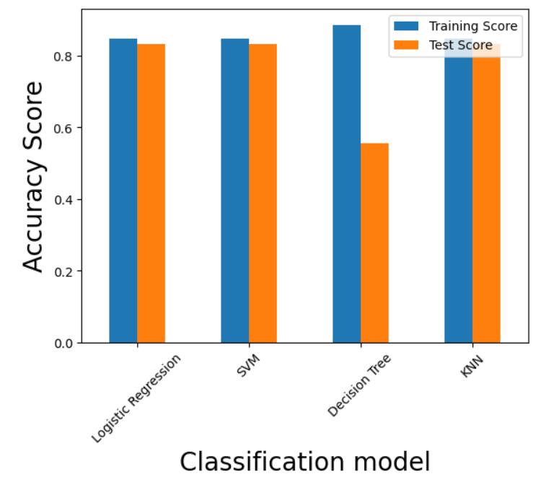
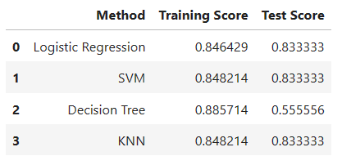
Classification Accuracy
The decision tree classifier yields the best accuracy score for the training dataset, but worst accuracy score for the testing dataset
Logistic Regression, SVM and KNN yields the best accuracy score for the testing dataset

Slide 44
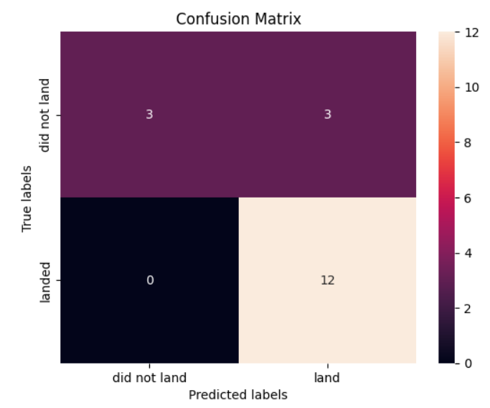
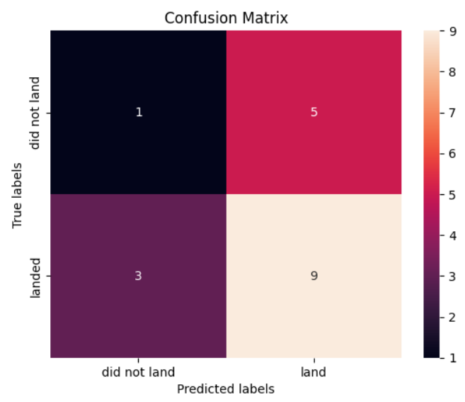
Confusion Matrix
The confusion matrix for Logistic Regression, SVM and KNN shows that the methods can distinguish between the different classes. The major problem is the false positives for the test dataset, .i.e. unsuccessful landing marked as successful landing by the classifier
The confusion matrix for the Decision Tree shows that the classifier struggles with false positives and false negatives for the test dataset
Logistic Regression
SVM
KNN
Decision Tree

Slide 45
Conclusions
The larger the flight amount at a launch site, the greater the success rate at a launch site
Launch success rate started to increase in 2013 till 2020
Orbits ES-L1, GEO, HEO, SSO, VLEO had the most success rate
KSC LC-39A had the most successful launches of any sites
The Decision tree classifier is the best machine learning algorithm for this task

Slide 46


